Slide 1

Final Presentation-Group 10
Capstone
13.12.2024

Slide 2
Overview
Final Product
This project is a chatbot implemented in Python using the Flask web framework, Hugging Face's Transformers library for natural language processing (NLP), and MongoDB for data storage.
The chatbot is designed to handle user inquiries about products, provide information, and engage in price negotiation.

Slide 3
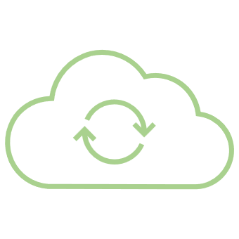
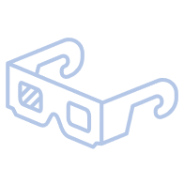

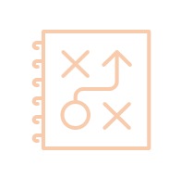
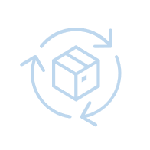
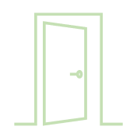
Project timeline
At-a-glance
Warm-Up
Planning
MVP
MMP
Evaluation
Details about the project and course
Detailed project plans created, including development of work breakdown structure.
Functional Prototype of 20% working product
Real working Product at least 75% delivered to PM
Documenting deliverables, conducting reviews, transitioning outcomes.
04
15
08
06
13
Oct
Oct
Nov
Dec
Dec

Slide 4
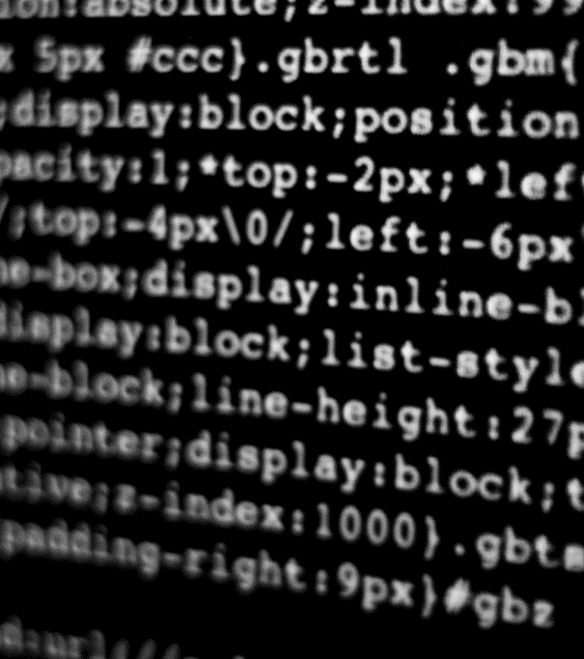
How we did it
Let’s Dive In

Slide 5
Key Components:
Flask Web Application: The chatbot is hosted as a web application using Flask. Chosen for its simplicity and flexibility as a web framework.
MongoDB Integration: Used to store product information in a database named 'ProductDB.’ Selected for its NoSQL nature, flexibility in handling unstructured data, and ease of scalability
Natural Language Processing (NLP): NLP is used to analyze user input, identify intents (greeting, product inquiry, negotiation), and generate appropriate responses. Ease of use in natural language processing tasks.
Web Interface: The chatbot's responses and negotiation state are sent back to the web interface for display

Slide 6
Flowchart

Slide 7
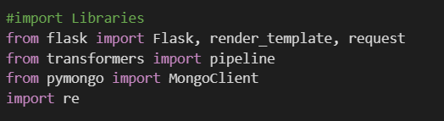
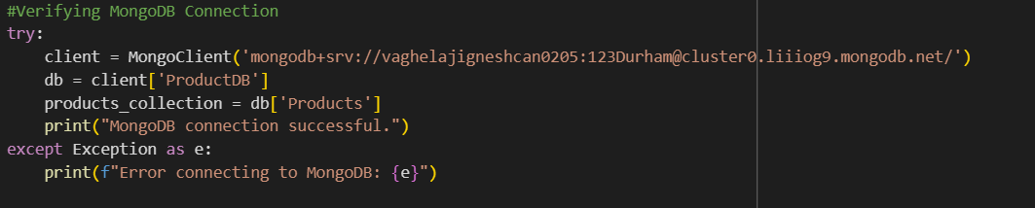
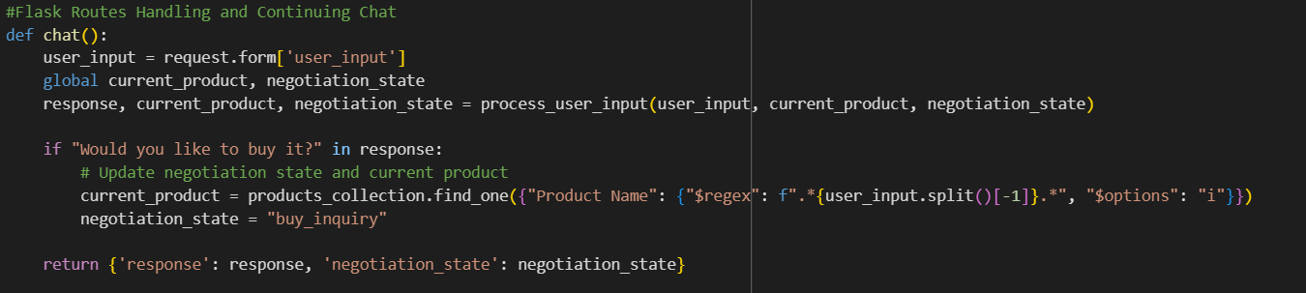
Main Code Elements

Slide 8
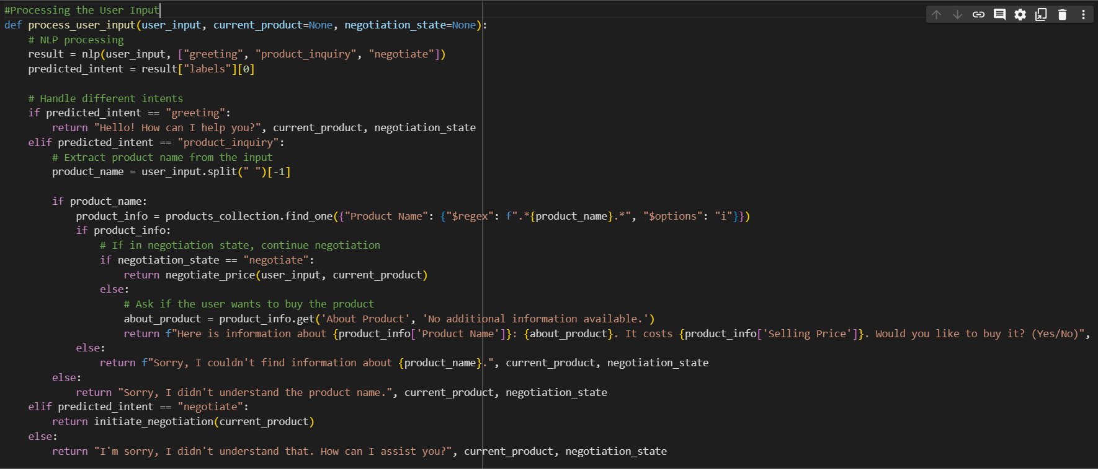
User Input

Slide 9
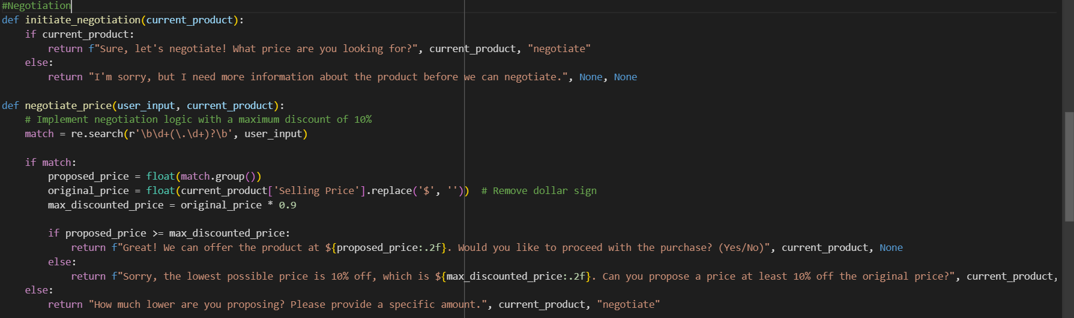
Negotiation

Slide 10
Output

Slide 11
Live Demo

